Slide 1

Celebal Technologies
We Manage Your Enterprise Needs, so You Can Manage Your Business

Slide 2

Mission statement:
We deliver Enduring Results
We combine Celebal Tech's global expertise with deep local insights to help our clients achieve their biggest goals. As lenders we understand the importance of transparency, accuracy and accountability in the services we offer and take pride in the quality of work we provide.

Slide 3
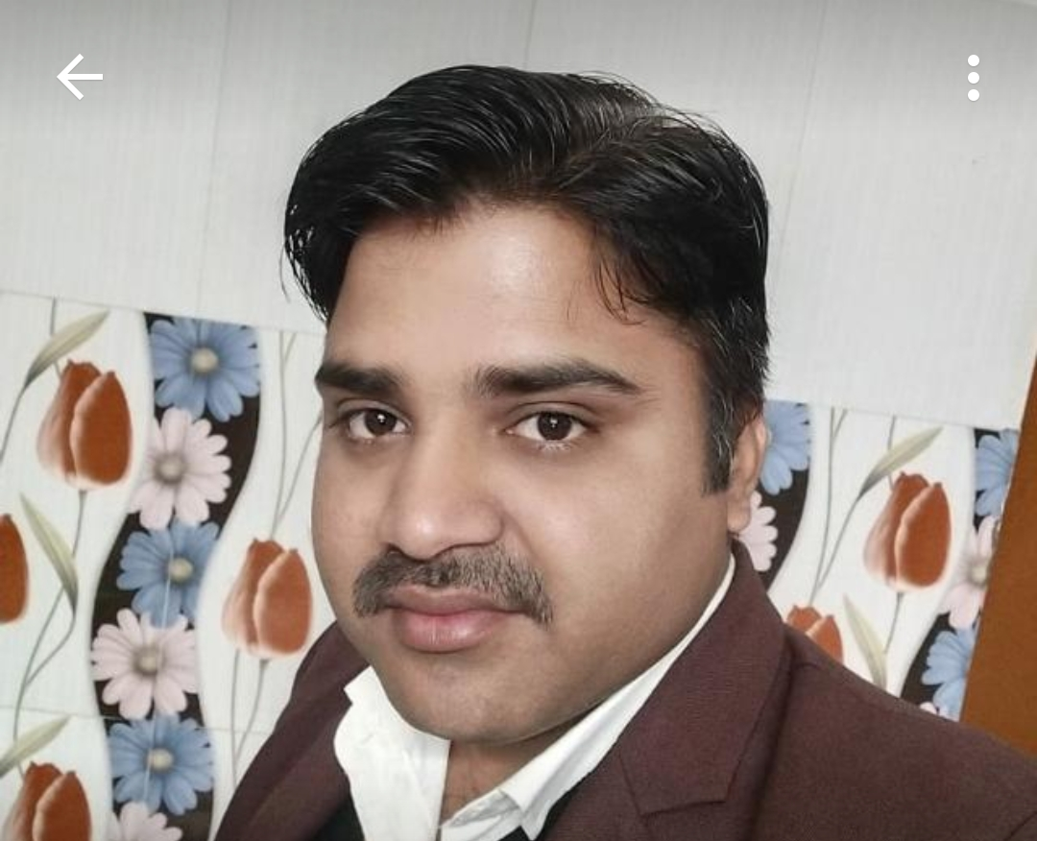
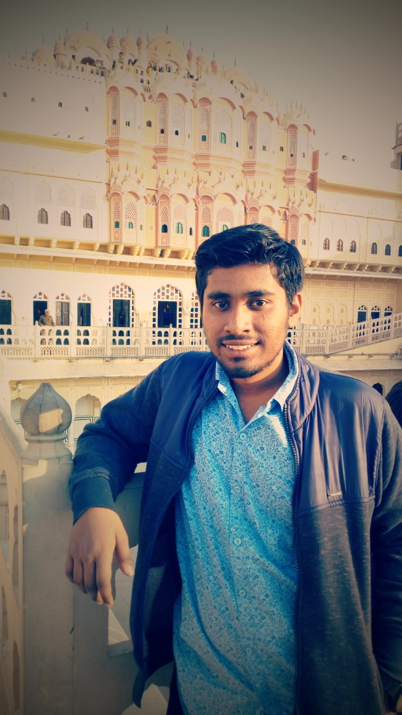
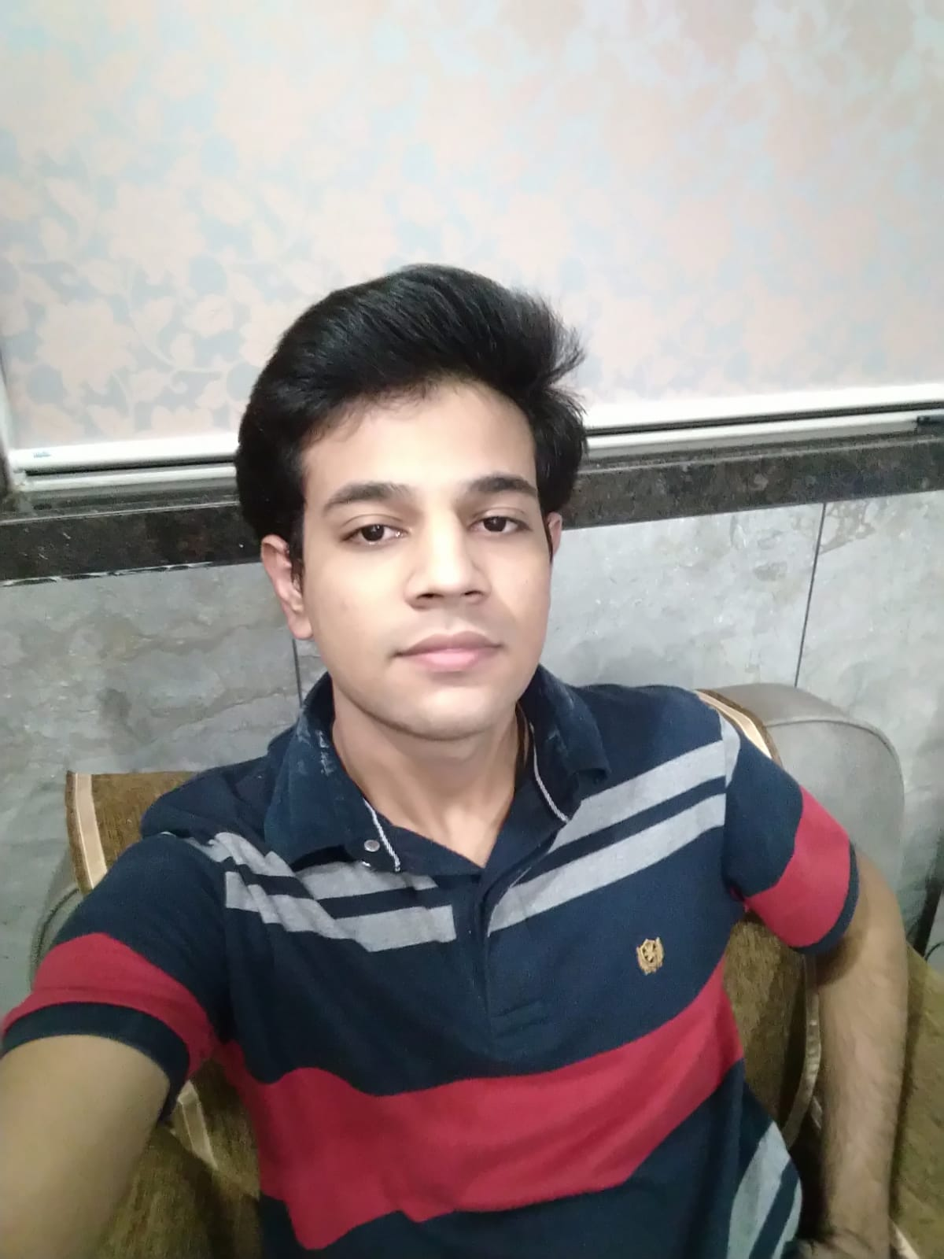
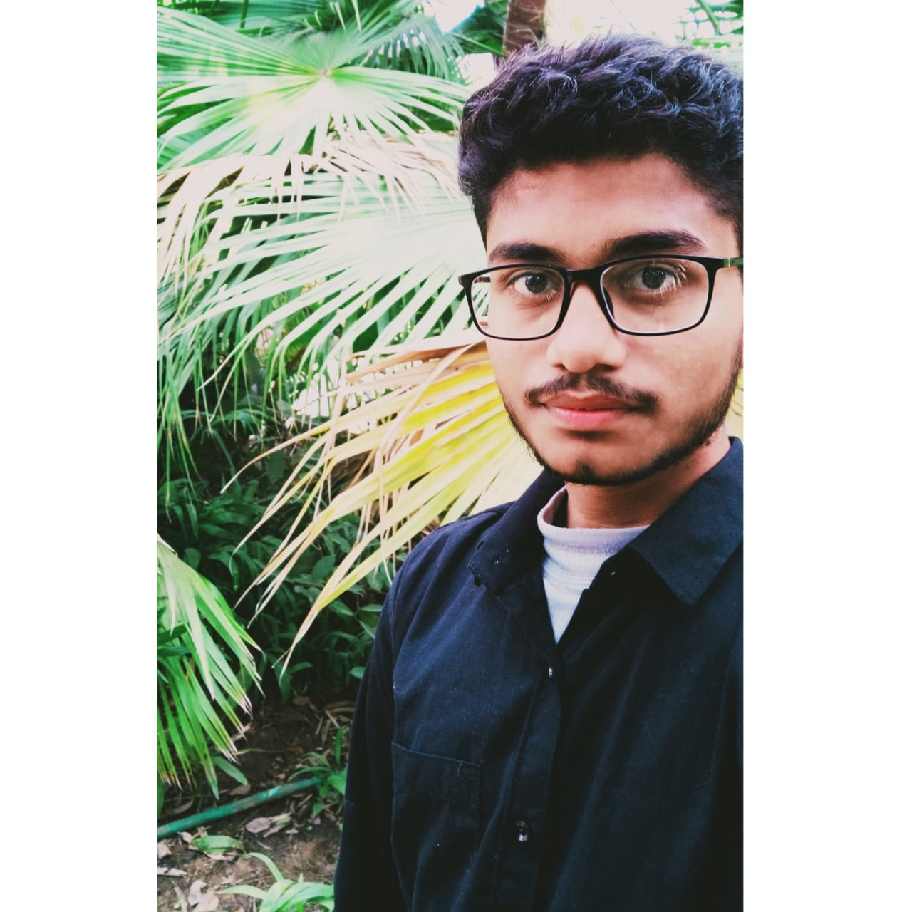
The team
Mr. Hemant Pareek
Vivek Chhangani
Sharve Parihar
Sailesh Verma
Faculty Mentor Assistant Professor JIET
Field of Interest: Data Analytics
Field of Interest: SQL
Field of Interest: Android

Slide 4

Objective: To extract the data from databases for the following case statements
SQL Project Planning
Placements
Symmetric Pairs
Interviews
15 Days of Learning SQL
Weather Observation Station 18
Occupations
New Companies
Binary Tree Nodes

Slide 5

The solution
Link :
The link provided will direct us to the queries applied on different databases to satisfy the case statements.
https://docs.google.com/document/d/1lst-AlQJkaGbmdOQCVGVjsHfT3yDWHCadQK3FwnjtOg/edit?usp=sharing

Slide 6

The Tools and Technology:
SQL , Hackerrank IDE

Slide 7
Advanced Joins
Sub-Query and Nested Query
Concepts Used
Pivot

Slide 8
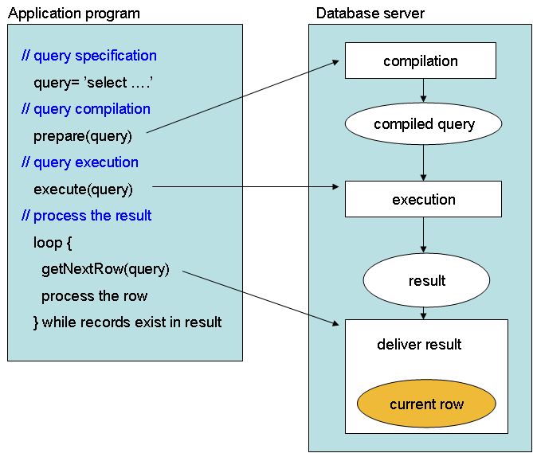
Applications of SQL
DDL (Data Definition Language)
Data Control Language (DCL)
Data Manipulation Language (DML)
Client or Server language

Slide 9
The Conclusion
Our overall experience in making the project was great. We have explored advanced knowledge of SQL such as Advanced Joins and Subqueries.
During discussions we have learnt about the already known concepts in more detail.
With all the knowledge we have and the guidance of Celebal Technologies and Mentor , We have successfully completed this project and learned a lot

Slide 10



